Slide 1
Tic-Tac-Toe Implementation using Multi Agents
Team members :
Vignesh Reddy Sama
Purna Vivek

Slide 2
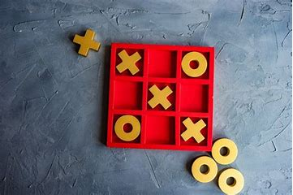
Introduction
This project uses the game of Tic-Tac-Toe to demonstrate how multiple AI agents can work with different strategies, such as offense and defense, to make smart decisions. Tic-Tac-Toe’s simple rules help us focus on how each agent thinks and adapts to the opponent’s moves, using methods like the minimax algorithm to find the best moves.

Slide 3
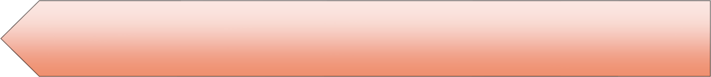
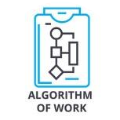


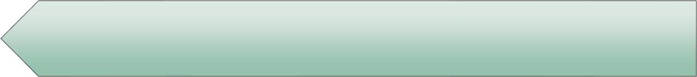




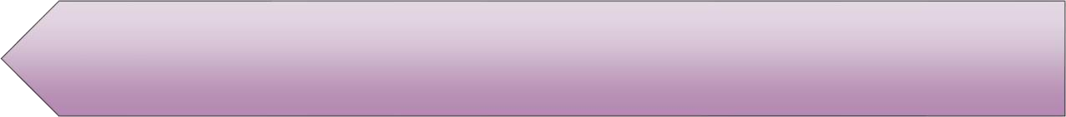
Objectives
Design Adversarial Search Algorithm and Reinforcement
Agents to solve Tic Tac Toe game.
Design of 3 Artificial Intelligence Agents: Q learning Technique , Min-Max Algorithm, Alpha-Beta Pruning
Plays Tic Tac Toe game multiple times among them to find the efficient Algorithm.
The player who gets the three consecutive symbols in a row or column or diagonally gains a winning point.
Compare the efficiency of three algorithms by calculating the corresponding performance metrics and to find out which performs better either adversarial search or Reinforcement Learning.

Slide 4
Approaches
The first Approach is Q- Learning from Reinforcement Learning
The Second approach is
Adversarial Search.
Min-Max Algorithm
Alpha-Beta Pruning.
Technology Stack : Python 3

Slide 5
Results
Documentation model which gives details
about the Tic Tac Toe game implementation
using Min- Max, Alpha-Beta and
Reinforcement Learning Agents.
Algorithms developed for AI Agents
using Python Programming
Language(.py files)
YouTube video Demonstrating project
implementation and slides
GitHub Repository link for Python
code and related files.

Slide 6


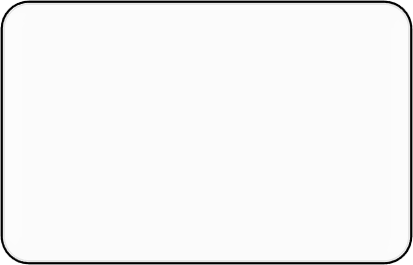


Evaluation Methodology
Project is evaluated based on the implementation of all the AI agents
Graphs depicting the performance comparisons
To determine the most efficient agent, tally the number of victories achieved by the agent in one-on-one matches played multiple times
A comparison table is given to the three agents based on the Tic Tac Toe moves, corresponding score, and win rate.
Time and space complexity comparison for the three agents will be implemented

Slide 7
THANK YOU!

